Slide 1
Pitching Evolution of College Baseball
A Machine Learning System for Modeling Stuff+, Location+, and Pitcher Development Using Division I TrackMan Data
Chris Jones

Slide 2
Background/Problem
Since 2022, Trackman (doppler radar system) has become streamline within NCAA Division 1 stadiums
Thousands of pitches are tracked each day in-depth giving advanced statistics such as iVB (induced vertical break), spin rate (in RPM), HB (horizontal break), velocity, and many other metrics
There is a lack of processing and understanding of these metrics and what pitch-types/shapes truly lead to success
The current methods used by College Baseball programs model pitches based on how they would succeed in Major League Baseball leading to poor correlation to the college game
The numbers have less deviation making it harder to understand the variation between a players pitches, and where development could be made

Slide 3
Dataset
My work with the Fordham Coaching Staff allowed access to the Private Trackman server
Server is on FileZilla
Updates daily, contains data from 2022-Present
Over 20,000 CSVs (0ver 25 Million individual pitches) were pulled using a Python ingestion script
These CSVs contain all game information including teams, innings, 5+ hitter metrics, 15+ pitcher throwing metrics, and player positioning

Slide 4
Two Models: Stuff+ and Location+
Stuff+ (CSW Based)
Predicts the probability that a pitching will be a called, or swinging strike
Uses only pitcher ball flight metrics — velocity, IVB, HB, spin, Ext, RelS, VAA, HAA — so it measures true pitch quality, not outcomes
LightGBM used to create model
Loc+ (Run-Value Based)
Predicts expected run value based on pitch location, count, and pitch type
This favors and uses command rather than raw stuff/”nastiness” of the pitch
LightGBM used to create model
Both models are scaled so 100 = Division I average, not MLB averages

Slide 5
Model Performance
Stuff+ (CSW Based)
ROC‑AUC: 0.70 - strong ranking ability despite class imbalance
Log Loss: 0.54 - well‑calibrated probabilities
Accuracy/Recall low by design due to rare CSW events
Takeaway: Model reliably distinguishes “nasty” pitches and produces stable probabilities for scaling into Stuff+
Loc+ (Run-Value Based)
RMSE: 0.163 vs 0.169 baseline
MAE: 0.067 vs 0.072 baseline
R²: 0.07 — typical for pitch‑level run‑value prediction
Takeaway: Model captures meaningful patterns in pitch location and count leverage, outperforming simple league‑average baselines

Slide 6
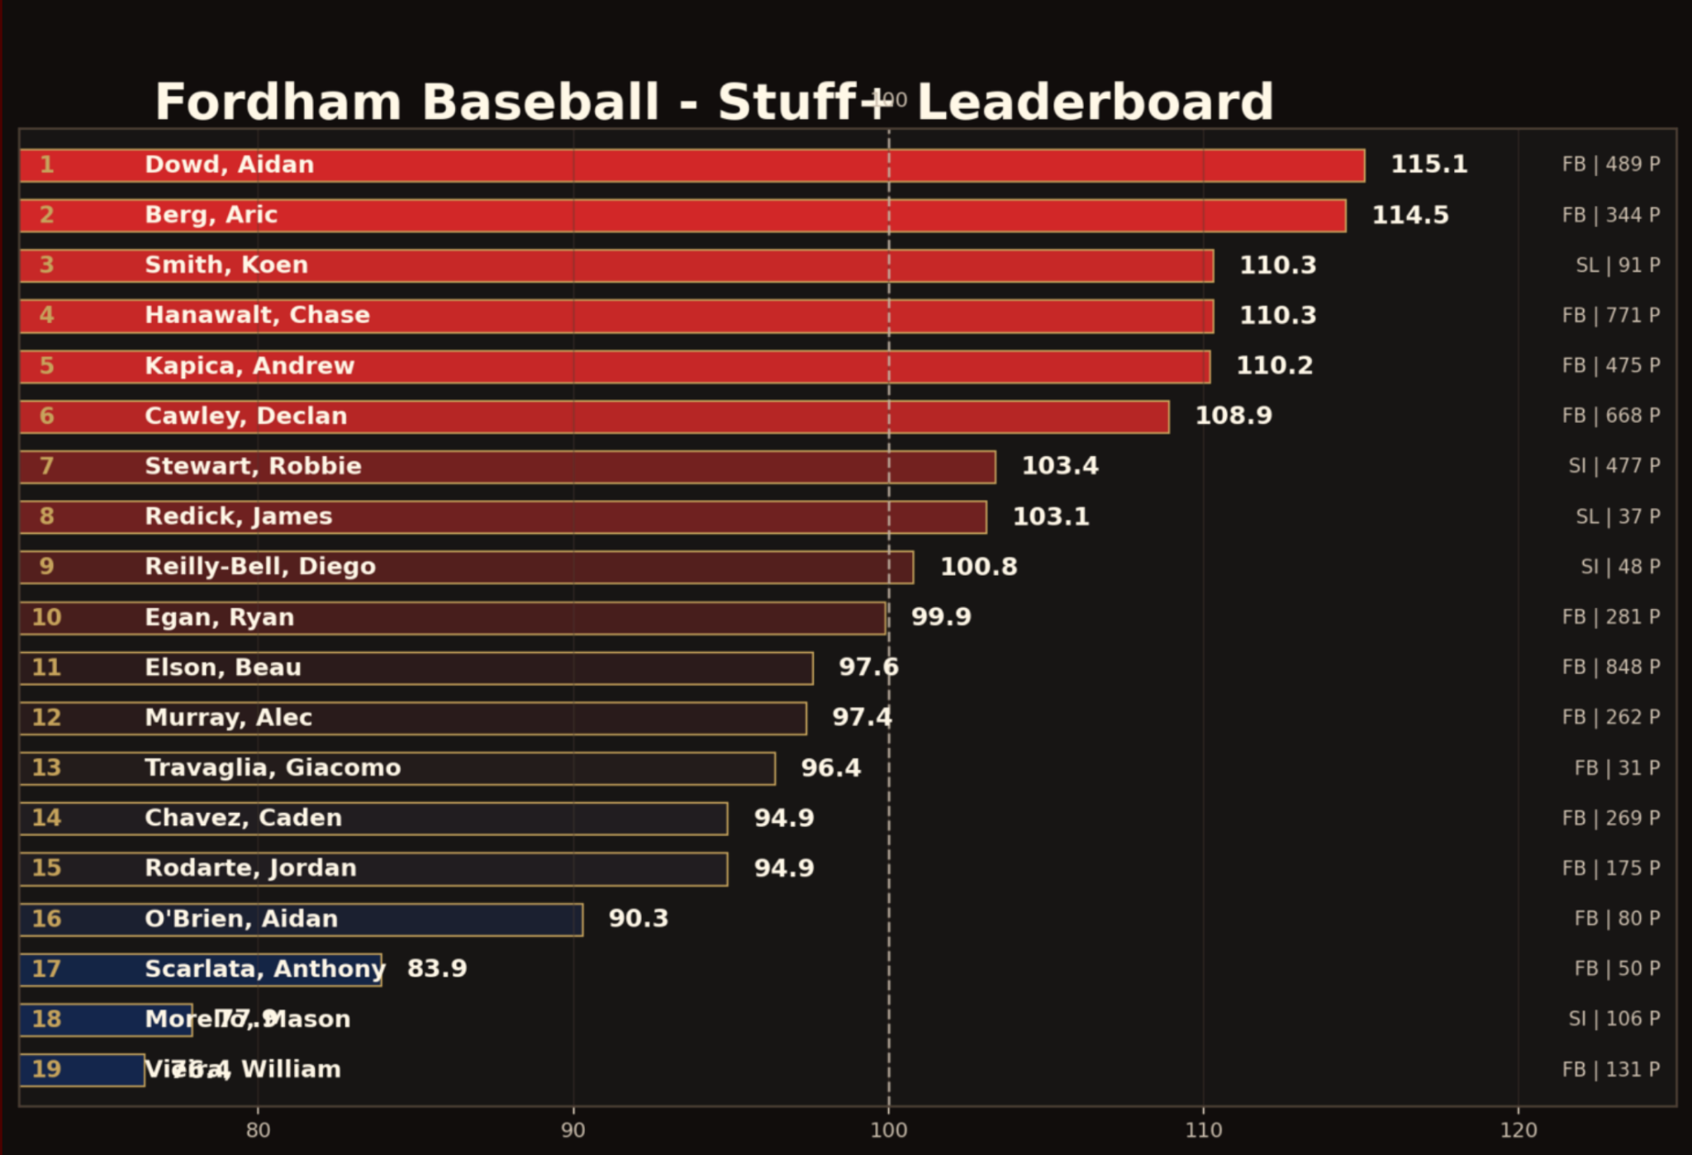
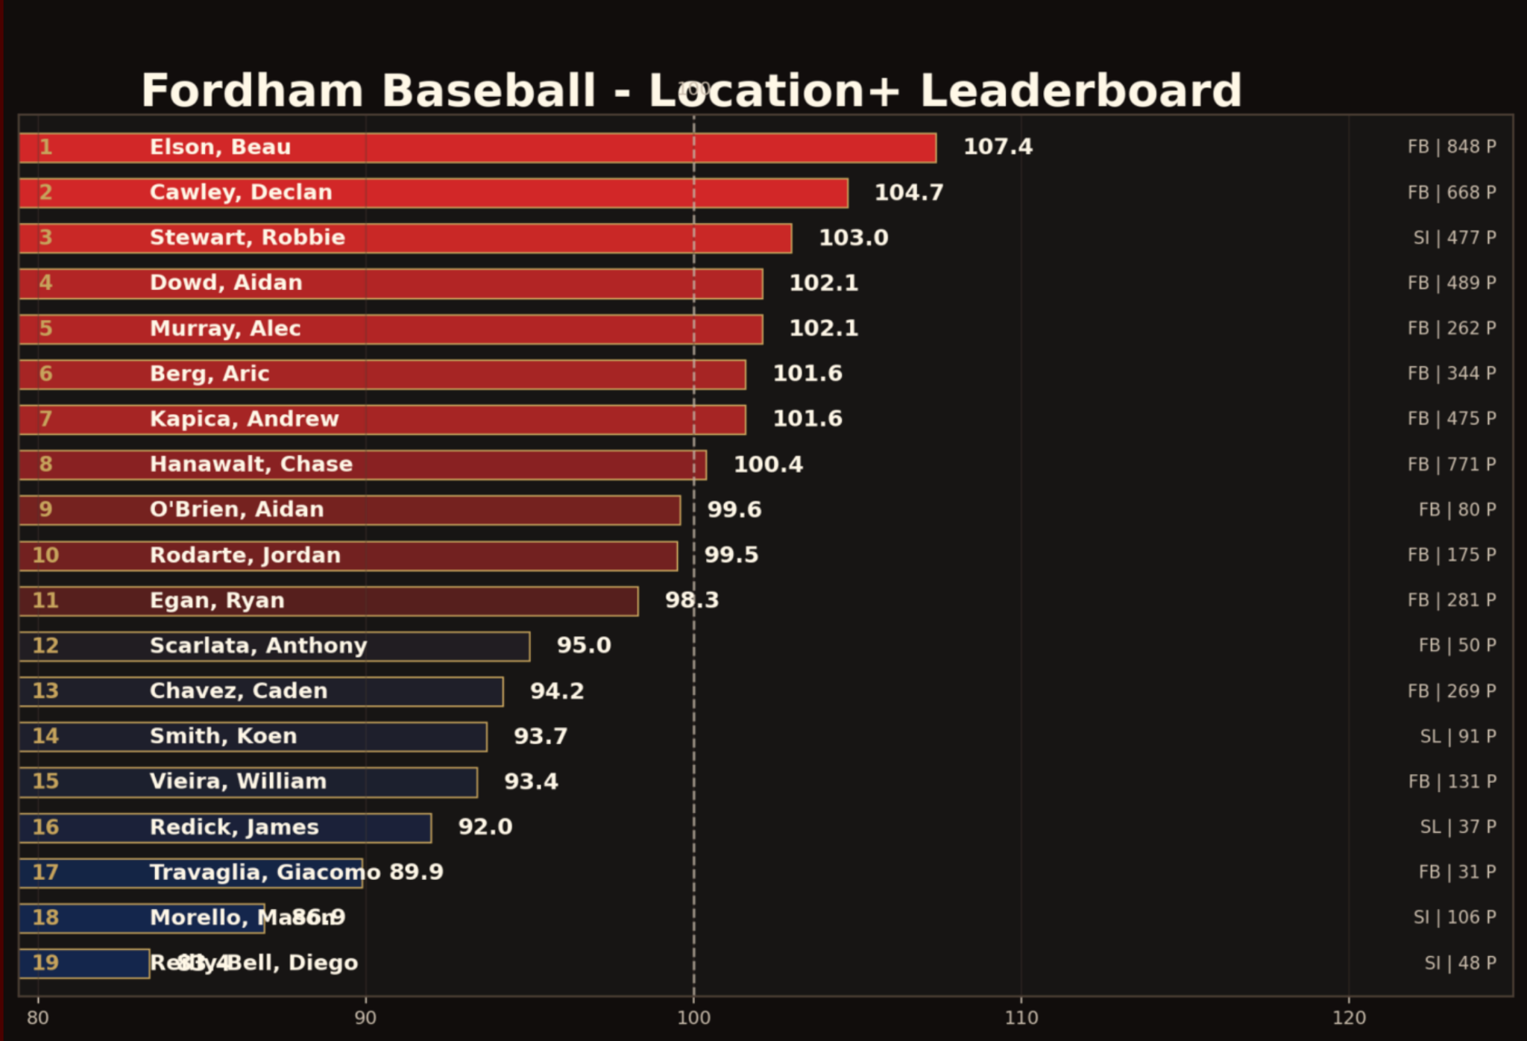
Leaderboards & Player Insights
Stuff+
Loc+
100 → exactly average for Division I
120 → one standard deviation above average (elite)
80 → one standard deviation below average

Slide 7
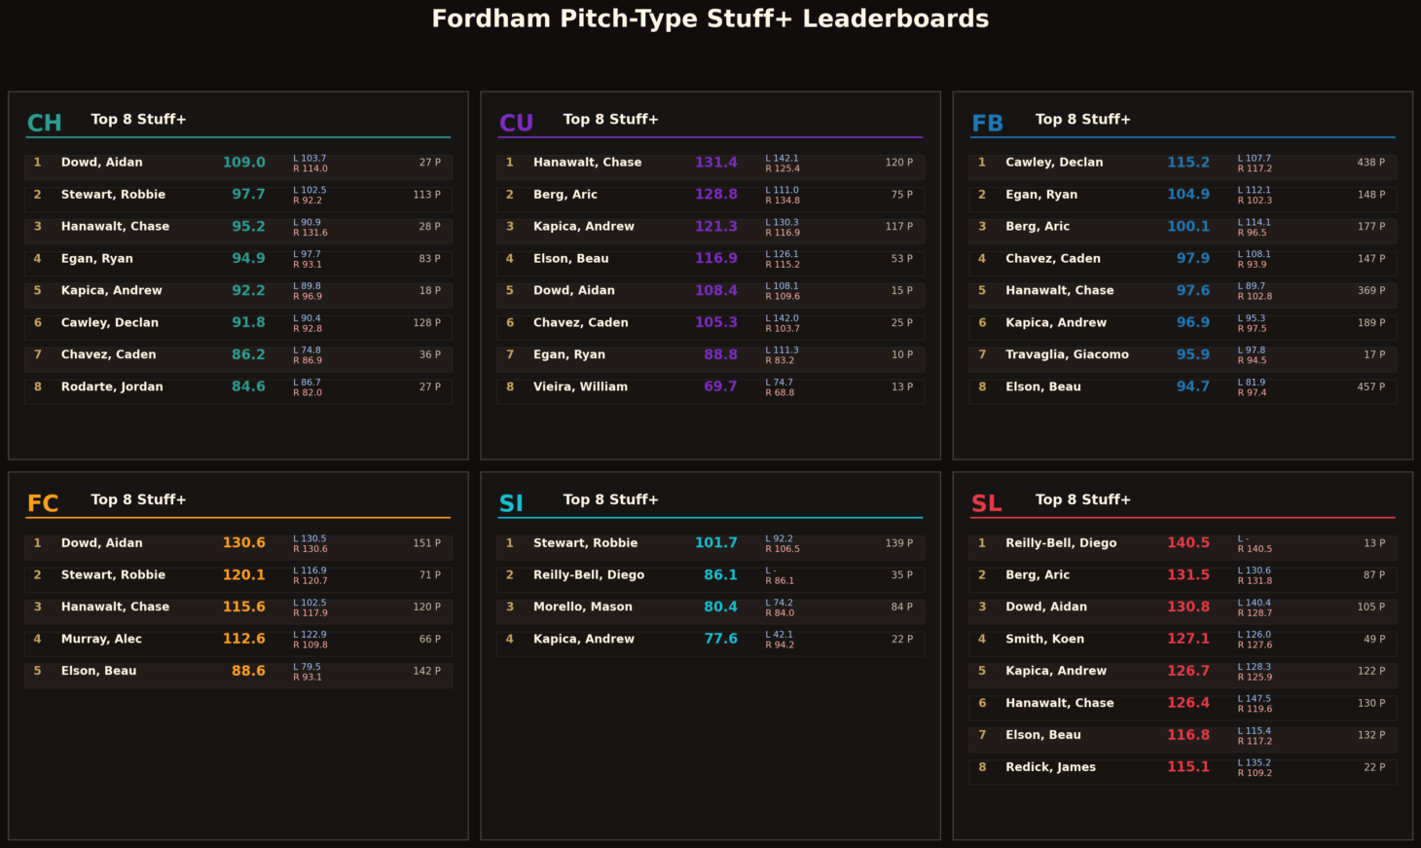
Leaderboards & Player Insights
Loc+

Slide 8
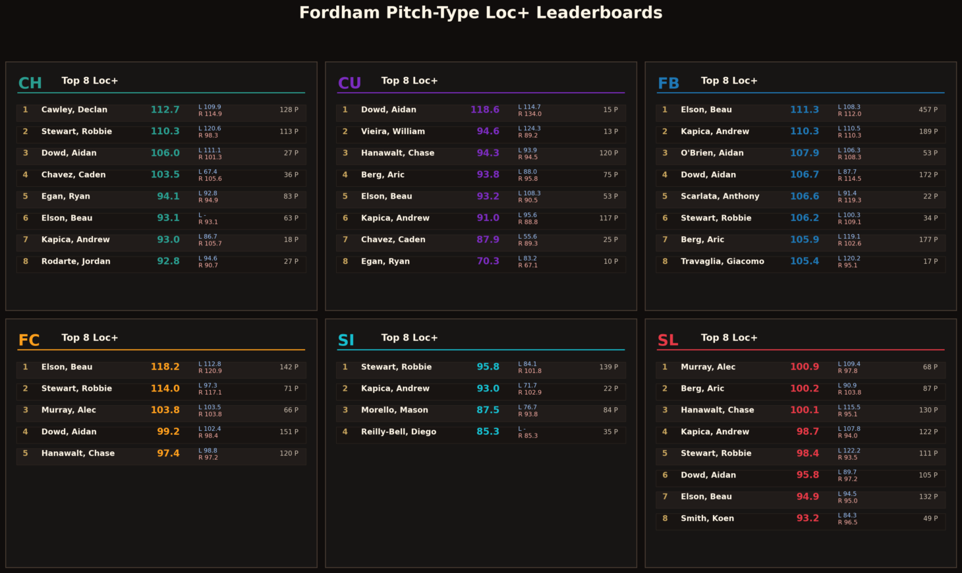
Leaderboards & Player Insights

Slide 9
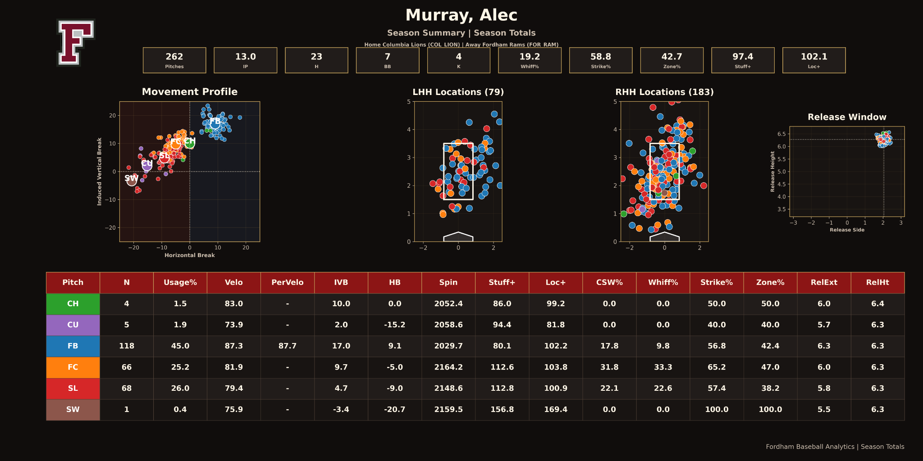
Example Usage
Case Study-Alec Murray: Throws his fastball 45% of the time, but it has a Stuff+ of 80.1 (below average). His cutter, thrown only 25.2% of the time, has a Stuff+ of 112.6 (elite). The Location+ for these pitches is also not far apart.
From this information, Alec’s cutter is an underutilized pitch. He would have more success on the mound if he used his cutter more than his FB. A clear, simple, actionable development insight.

Slide 10
Conclusion
The project produced:
A Division I–calibrated Stuff+ and Location+ system for correcting understanding and scaling at the college game
A scalable ingestion and feature‑engineering pipeline
Machine learning models built on 25M+ pitches and 4 years of NCAA Data
A deployed analytics platform based on Streamlit for real player development
Future Goal:
Develop application with models so it can be sold as a service to other NCAA Baseball coaches so they can improve player development!

Slide 11
Works cited:
[1] Driveline Baseball, “Revisiting Stuff+,” 2024.
[2] FanGraphs, “Stuff+, Location+, and Pitching+ Primer,” 2023.
[3] CornBelters Baseball, “Stuff+ in Collegiate Baseball,” 2023.
[4] Rockland Peak Performance, “What Is Stuff+ and How Can It Help
You?,” 2022.
[5] LightGBM Developers, “LightGBM: A Highly Efficient Gradient Boost-
ing Framework,” 2017.
[6] Microsoft, “Streamlit Cloud Documentation,” 2024.
[7] MLB Baseball Savant, “Baseball Savant: Statcast Search and Pitch
Tracking,” 2024.
[8] TrackMan Baseball, “TrackMan Baseball System Overview and Tech-
nical Specifications,” 2024.

